Slide 1
Racket Project
Amir Kallel
Suresh Dharani Parasuraman
Alexander Kozhinov

Slide 2
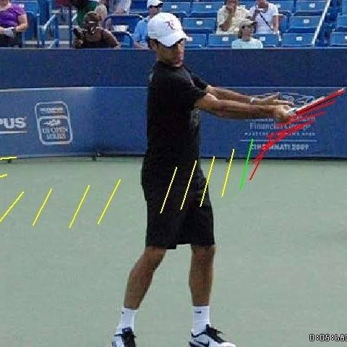
The Idea again
Source: [https://www.quora.com/How-do-you-put-spin-on-a-tennis-ball]
5/10/17
Racket Project

Slide 3
Outline
Modeling the perfect tennis swing
IMU embedded in the racket
Live data plotting & fitting
5/10/17
Racket Project

Slide 4
Modeling the Perfect Tennis Swing
20 Tennis swing motions performed separately with LG smart watch worn on wrist.
Sensor data recorded individually using cmotion Android app:
Acceleration
Magnetic Field
Gyroscope
9 data set [3 axis per sensor] analyzed and plotted using MATLAB
5/10/17
Racket Project

Slide 5
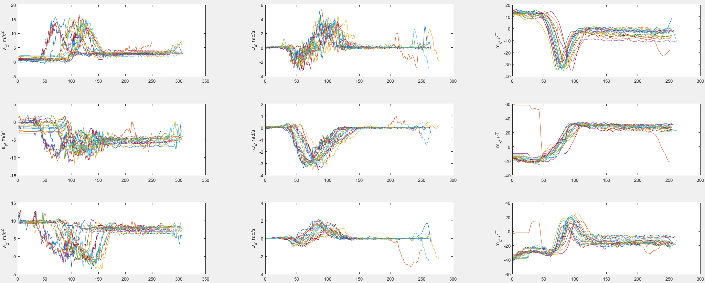
Modeling the Perfect Tennis Swing
However, 20 data swings have different time shifts
5/10/17
Racket Project

Slide 6
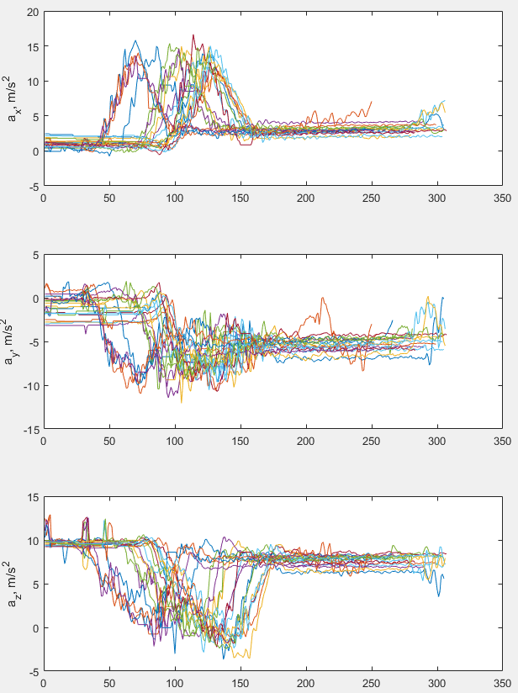
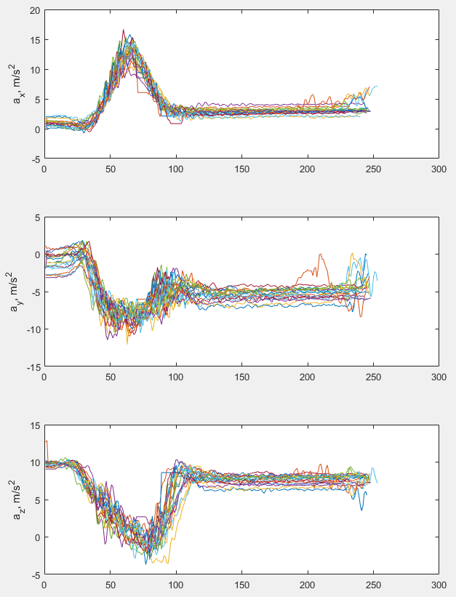
Modeling the Perfect Tennis Swing
Acceleration X-axis time shift example
5/10/17
Racket Project

Slide 7
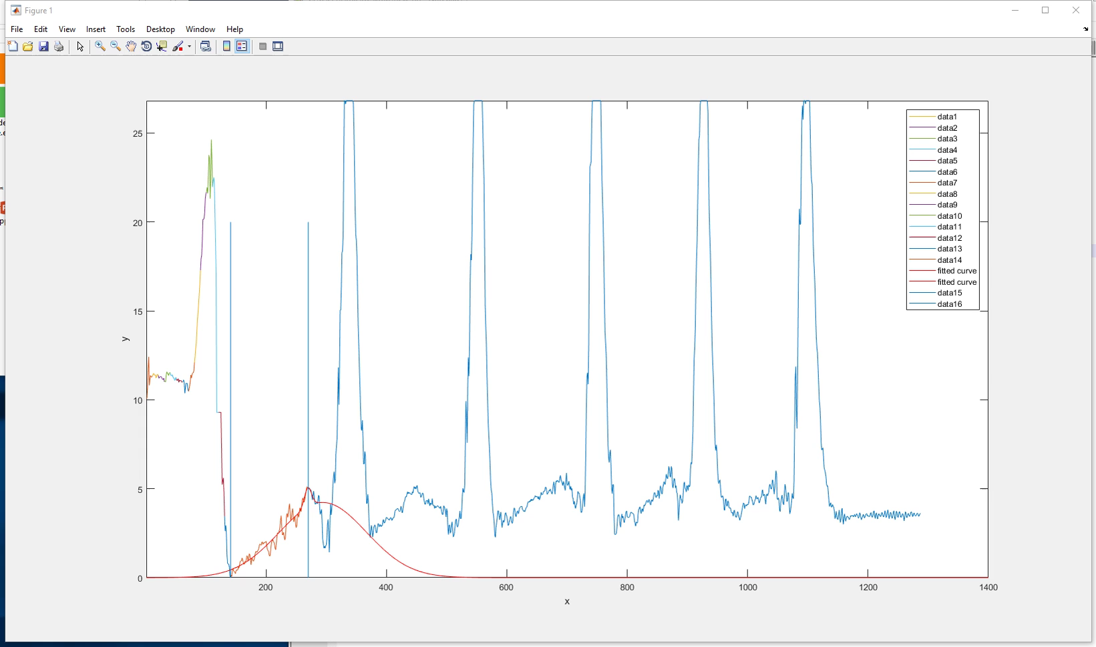
Modeling the Perfect Tennis Swing
Identifying the most suitable fit type
Using dynamic Matlab script
Trial & Error for domain knowledge of data
5/10/17
Racket Project

Slide 8
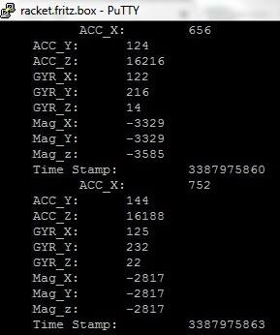
IMU embedded in the racket
Using an MPU9150 IMU Sensor connected to Intel Edison
The same 3 sensor data acquisition with predefined timestamp
C++ written software
TO DO:
UDP data transmission
5/10/17
Racket Project

Slide 9
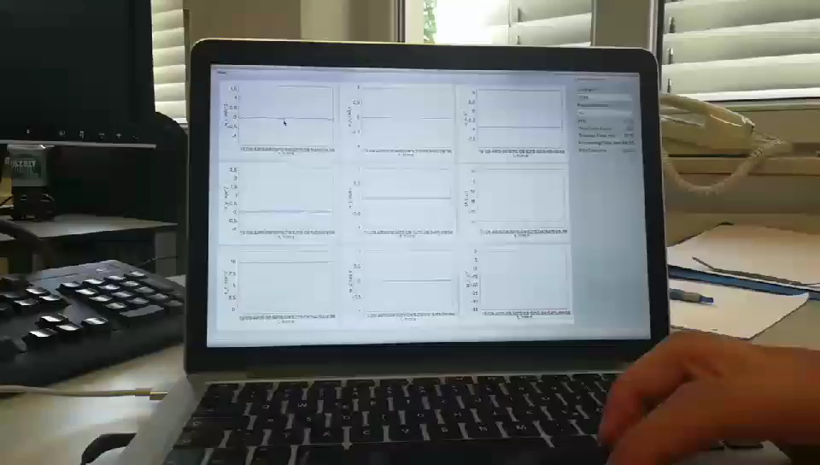
Live data plotting & fitting
C++ app reading live stream sensor data over UDP [sent from smartphone]
Low response time for visualization
5/10/17
Racket Project

Slide 10
Next Steps
Interfacing the features already separately implemented.
3D print the IMU case to be embedded on the racket
Optional:
Determining the tennis swing quality after detection
Implementing a wear app to notify the tennis player of his swing quality and/or statistics.
5/10/17
Racket Project

Slide 11

Q & A
5/10/17
Racket Project

